Slide 1
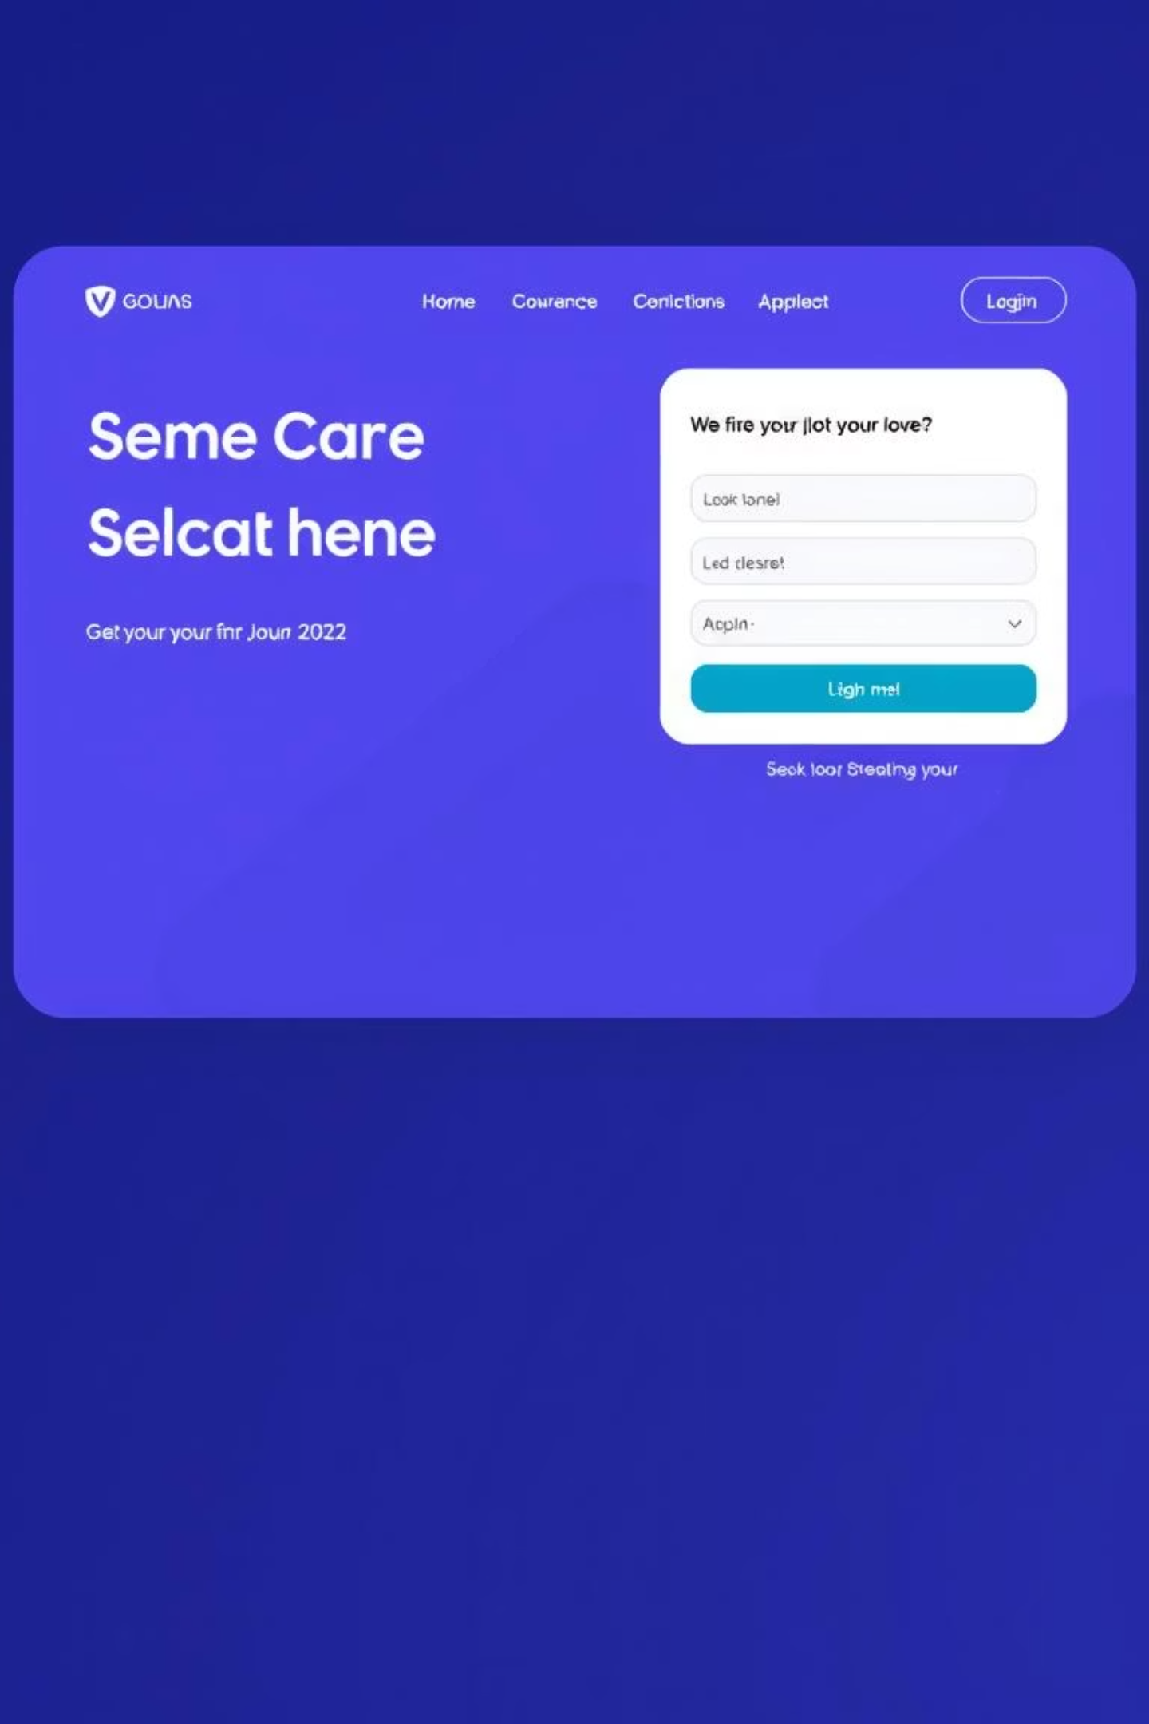
🚀 Advancing Loan Applications: A Digital Transformation
Modernising the loan application process with an intuitive, secure, and highly scalable digital platform, designed to significantly accelerate processing times and enhance administrative efficiency.

Slide 2
Project Objectives
Seamless Digital Experience
Accelerated Processing
Enhanced Transparency
To provide customers with an intuitive online platform for Home, Personal, and Car loan applications.
To significantly reduce loan processing times through automation and digital workflows.
To offer real-time application status tracking for customers and efficient admin management.

Slide 3






Core Features for Customers
Secure Access
Loan Selection
Effortless customer registration and secure login process.
Options to select Home, Car, or Personal loan types.
EMI Calculator
Eligibility Check
Integrated EMI calculator for financial planning and informed decisions.
Automated eligibility assessment based on age, income, and credit score.
Document Upload
Status & Alerts
Streamlined KYC and income document submission.
Real-time application status tracking and email/SMS notifications.

Slide 4
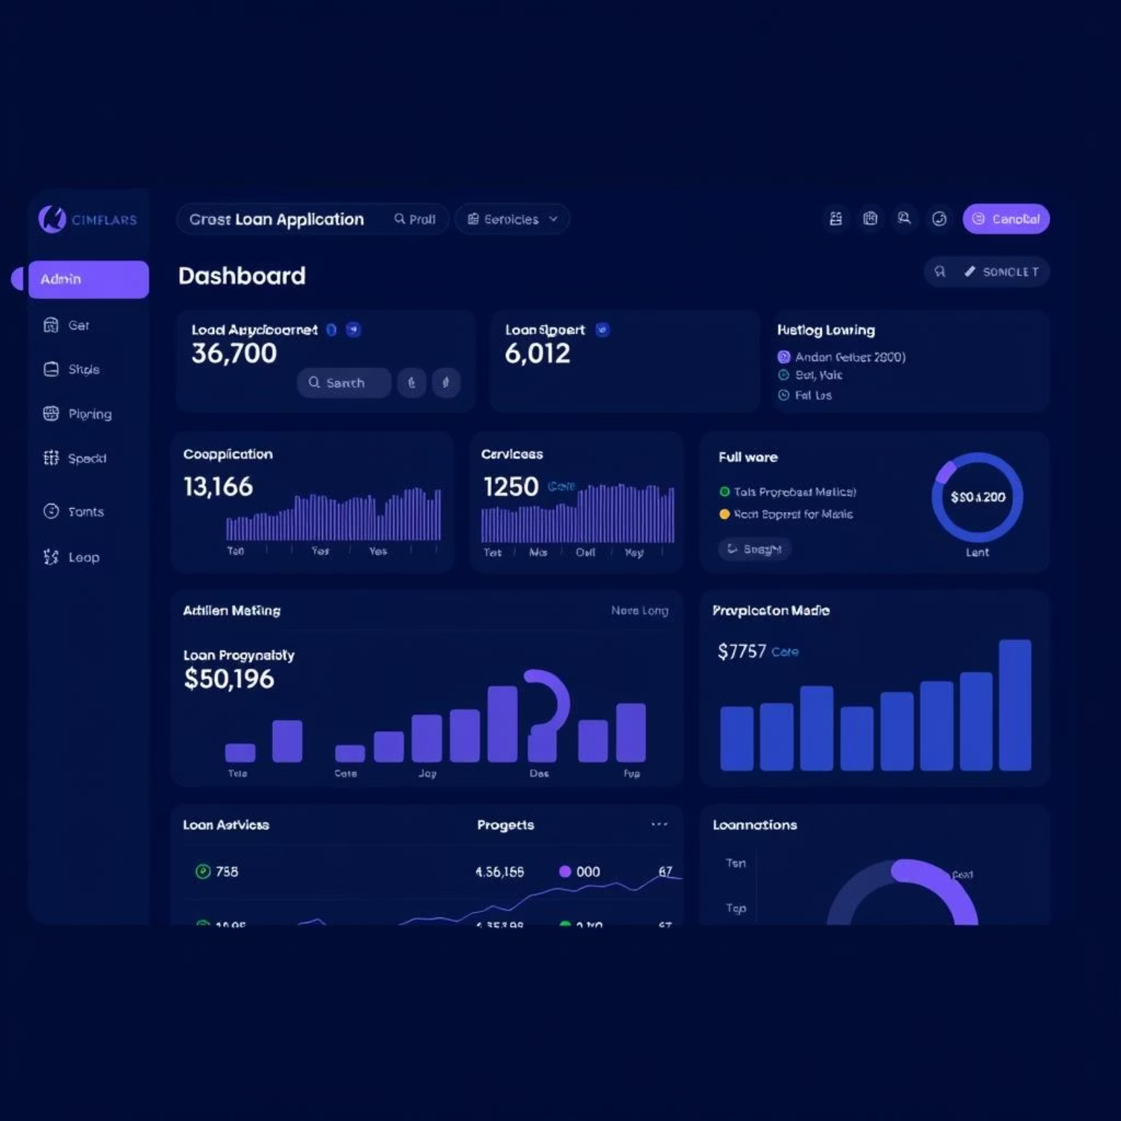
Streamlined Admin Capabilities
Comprehensive dashboard for all loan applications.
Efficient document filtering and verification.
Single-click approval or rejection of applications.
Automated notification triggers for all updates.

Slide 5
User Journey: Customer Perspective
1
2
Digital Application
Secure Uploads
Apply for various loan types from anywhere, anytime.
Upload necessary documents with robust security measures.
3
4
Real-time Updates
EMI Calculation
Track application status and receive instant notifications.
Utilise the calculator for transparent repayment planning.

Slide 6




User Journey: Admin Perspective
Manage Applications
Verify Documents
Centralised system to oversee all incoming loan applications.
Tools to quickly filter and verify submitted customer documents.
Approve/Reject
Automated Notifications
Streamlined process for making and actioning decisions.
System-triggered alerts to keep customers informed.

Slide 7
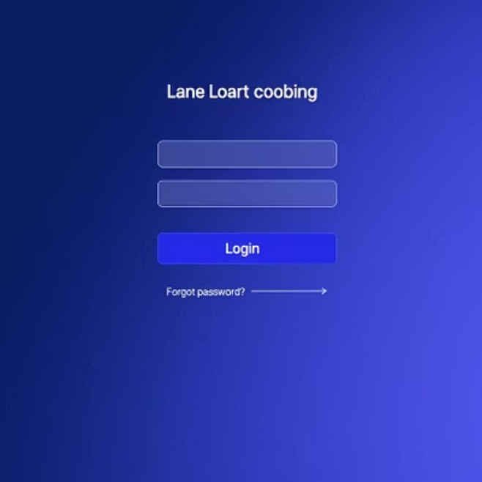
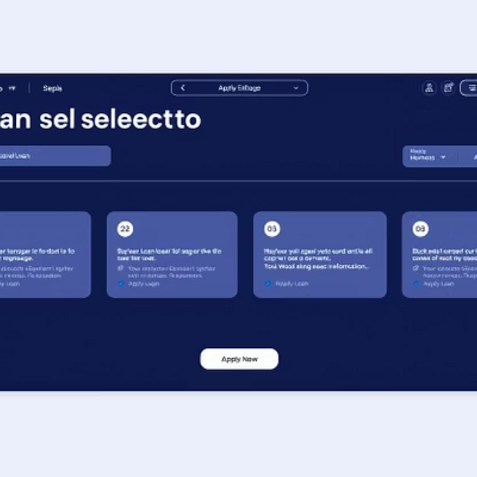
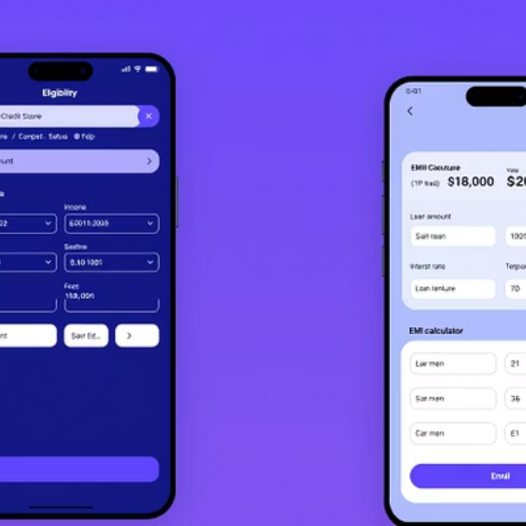
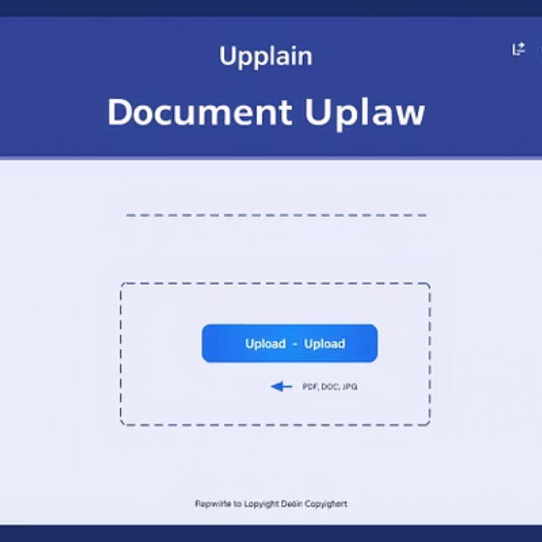
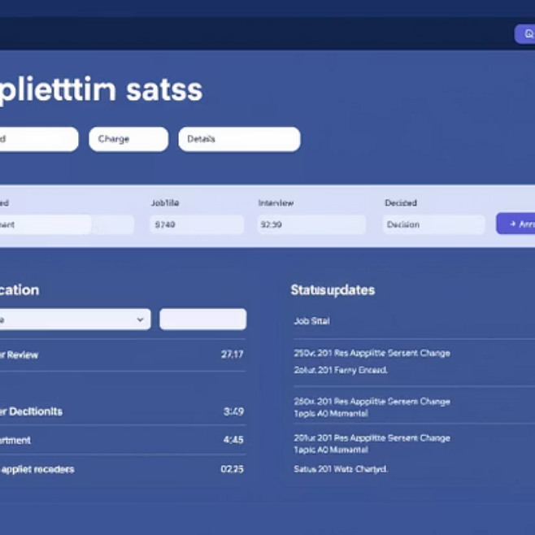
Wireframe Previews: Customer Interface
Visual mock-ups demonstrating the intuitive user flow from login to application tracking.

Slide 8
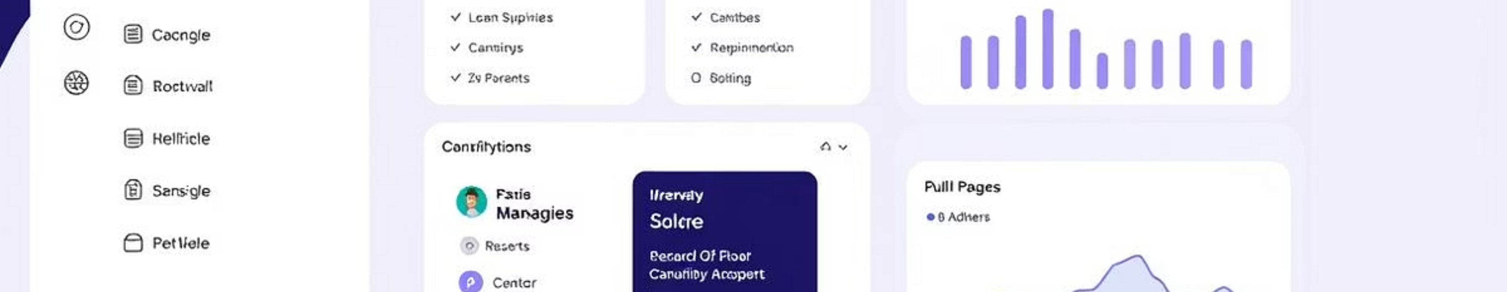
Wireframe Preview: Admin Panel
A glimpse into the administrative interface, designed for efficiency and oversight.

Slide 9
Tools and Technologies Utilised
ChatGPT
Grok AI
Leveraged for generating detailed documentation and crafting precise user stories, ensuring clarity and comprehensive coverage of system functionalities.
Utilised for structuring and refining complex information, providing intelligent insights for optimal system architecture and process flows.

Slide 10



Conclusion & Next Steps
Project Success
Future Enhancements
Collaboration
The system effectively addresses the need for a modern, secure, and user-centric loan application process.
Potential for integrating AI-driven credit assessment and expanded loan product offerings.
Continued collaboration with stakeholders to gather feedback and refine the platform.

